Slide 1

Methods for Causal Inference in Educational Research
January/February 2022
Isa Steinmann

Slide 2
5 | Regression Models Time: 31 January 2022, 12:15-14:00h Main instructor: Isa Steinmann Required reading: Angrist & Pischke (2015), chapter 2
6 | Further Control Strategies Time: 03 February 2022, 12:15-14:00h Main instructor: Isa Steinmann Required reading: -
7 | Instrumental Variable Approaches Time: 07 February 2022, 12:15-14:00h Main instructor: José Manuel Arencibia Alemán Required reading: Angrist & Pischke (2015), chapter 3
8 | Regression Discontinuity Designs I Time: 10 February 2022, 12:15-14:00h Main instructor: José Manuel Arencibia Alemán Required reading: Angrist & Pischke (2015), chapter 4

Slide 3

Take-away messages
If selection mechanism is well-known and can be captured with indicators, regressions can control for selection mechanisms (in social sciences, this is usually not the case)
Omitted variable bias (i.e., selection bias) if control variables do not capture whole selection mechanism
If regressions used for causal research questions, importance of justification of control strategy, balance checks, and sensitivity analyses

Slide 4
Overview
Example study: Propensity score matching
Example study: Pretest data and fixed-effects
Midway evaluation

Slide 5

What do you remember from the
preschool example last week?

Slide 6
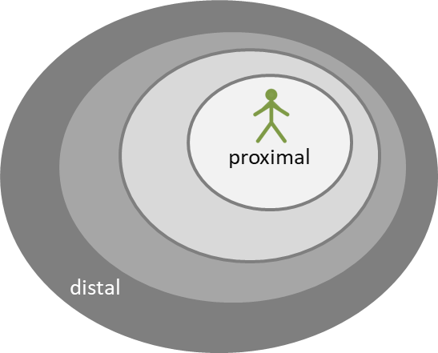
Preschool example I
Main aims of expanding preschool:
Compatibility of family and career
Improvement of preparation for school
Families and preschools are the most important learning environments for young children
Preschool is expected to foster later achievement
Steinmann et al. (2016)

Slide 7
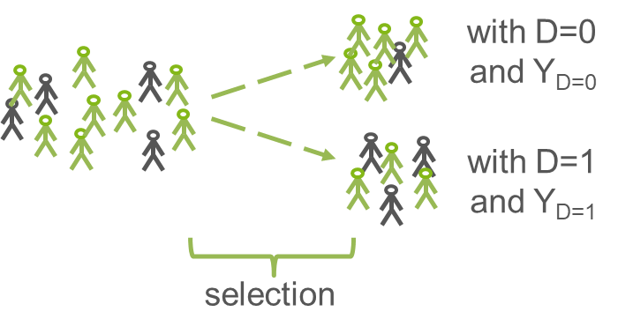
Preschool example I
Selection into preschool
Family income
Parental education
Parental occupation
Availability of care options in family
Migration background
… (cf. Early & Burchinal, 2001; Grogan, 2012; Kim & Fram, 2009)
Steinmann et al. (2016)

Slide 8
Preschool example I
R exercise last week supported selection mechanism assumptions
Reading achievement advantage of treated children decreased once control variables were included
Omitted variable bias could not be ruled out in regression study
Steinmann et al. (2016)

Slide 9

Preschool example II
“the purpose of the current study is to investigate the effect that preschool participation might have on non-participating grade-four-students’ reading achievement using the PIRLS 2011 data by employing propensity score matching” (pp. 4-5)
→ What if those who did not attend would have attended?
Hogrebe & Strietholt, 2016

Slide 10
Preschool example II
Nine countries from PIRLS 2011:
Chinese Taipei(n = 4293)
Germany (n = 4000)
New Zealand (n = 5644)
Norway (n = 3190)
Russia (n = 4461)
Singapore (n = 6367)
Slovakia (n = 5630)
Spain (n = 8580)
Sweden (n = 4622)
Hogrebe & Strietholt, 2016

Slide 11
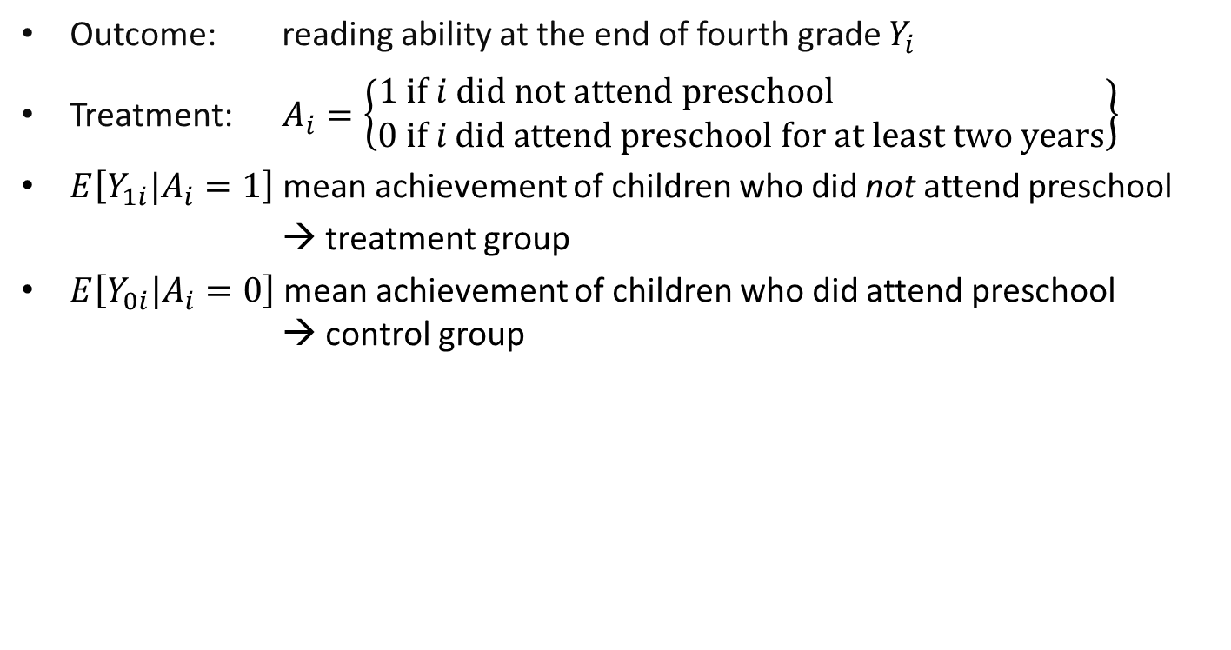
Preschool example II
Hogrebe & Strietholt, 2016

Slide 12
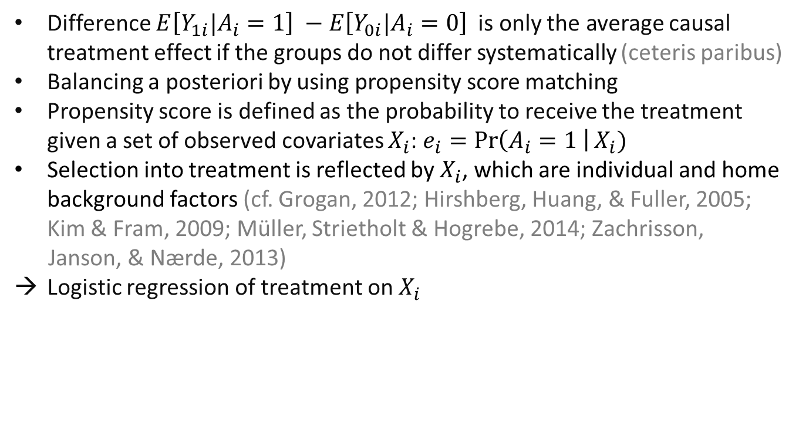
Preschool example II
Hogrebe & Strietholt, 2016

Slide 13
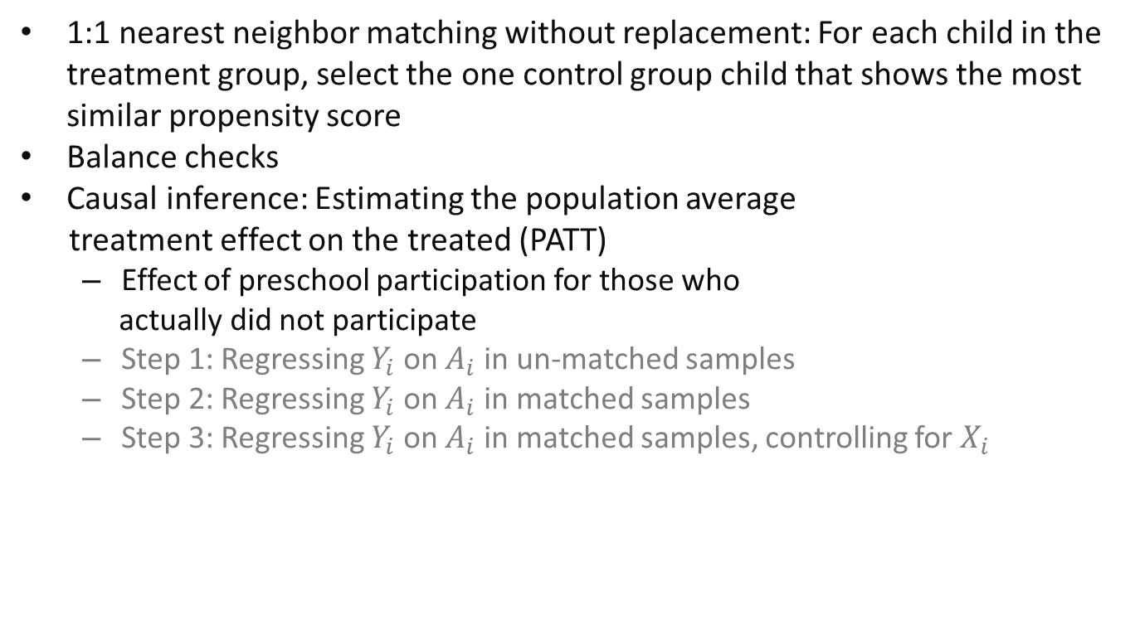
Preschool example II
Hogrebe & Strietholt, 2016

Slide 14
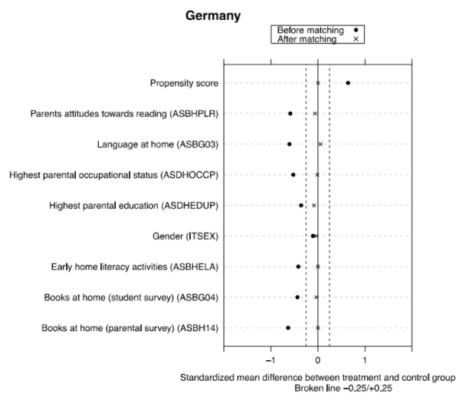
→ balance attained
Hogrebe & Strietholt, 2016

Slide 15
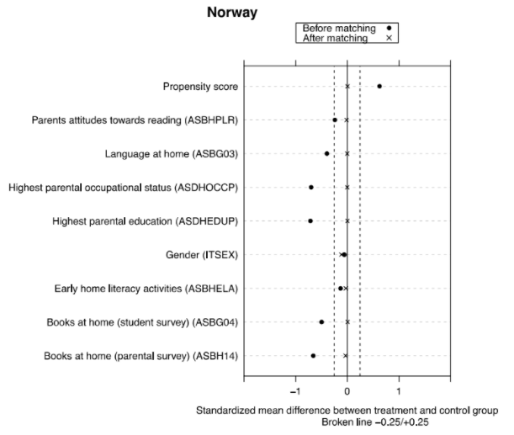
→ balance attained
Hogrebe & Strietholt, 2016

Slide 16

→ no balance attained!
Hogrebe & Strietholt, 2016

Slide 17
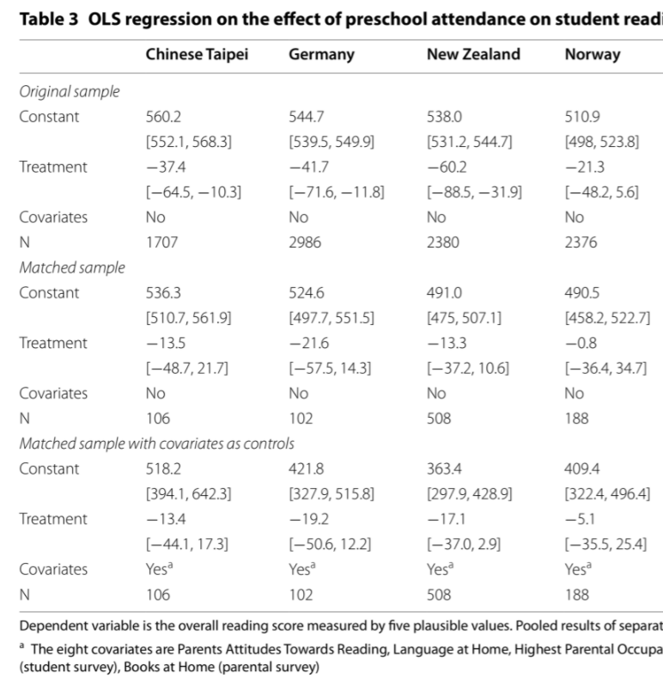
→ after matching, treatment effect no longer significant in Germany
Hogrebe & Strietholt, 2016

Slide 18
Preschool example II
Except in Russia, non-attendance was rare
In all 9 countries, non-attendance was associated with socioeconomic disadvantage and lower achievement
In Slovakia, non-attending children form a socioeconomically disadvantaged subgroup without sufficient matches in group of attending children
Limited evidence that preschool attendance of children who did not attend would affect reading achievement
In Chinese Taipei, Germany, New Zealand, Norway, Russia, Slovakia, and Spain, achievement disadvantage is not significant when 1:1 matching and control variables
In Singapore and Sweden, a reading advantage remains
Hogrebe & Strietholt (2016)

Slide 19
Preschool example II
Ignorable treatment assignment assumption: no hidden bias from unobserved covariates (Rosenbaum & Rubin, 1983)
It cannot be ruled out that selection mechanism variables were omitted!
However, if students who did not participate were even more disadvantaged than observed, we would overestimate the group differences which are now already non-significant
Hogrebe & Strietholt (2016)

Slide 20
What does propensity score
matching do?

Slide 21
Matching methods
Matching aims to balance treatment and control groups (ceteris paribus)
Unlike control strategies in regressions, matching is a preprocess for later analyses
→ if matching process successful, simple t-tests sufficient for analyses
Logistic propensity score regression → propensity score reflects the likelihood of an individual to receive the treatment
Matching of units who had a similar likelihood to receive treatment and did vs. did not receive it
Ho, Imai, King, & Stuart, 2011

Slide 22
Matching methods
Selection of covariates X and selection model are crucial
variables that reflect selection mechanism (associated with treatment/control group allocation AND outcome)
variables’ non-linearity and interactions
variables measured prior to outcome
never include outcome in selection model!
Different matching methods (aim should be to include all treated units (interpretability, generalizability,...) but excluding control units is ok)
nearest-neighbor matching
exact matching
optimal matching
…
Ho, Imai, King, & Stuart, 2011

Slide 23
Balance checks
Matching results in adjusted (and reduced) sample
Distribution of covariates must be the same within matched treatment and control groups 🡪 imitation of randomized trials
Three measures of balance (cf. Rubin, 2001; Stuart, 2010):
Standardized bias
Ratio of variances of propensity scores
Ratio of variances of the residuals of the covariates after propensity score regression
Graphic measures (e.g., Q-Q plot, love plot)
“Because the outcome variable is not used in the matching procedure, any number of matching methods can be tried and evaluated, and the one matching procedure that leads to the best balance can be chosen” (Ho et al., 2011, p. 7)
Ho, Imai, King, & Stuart, 2011

Slide 24
Three advantages of matching
“First, matching methods should not be seen in conflict with regression adjustment and, in fact, the two methods are complementary and best used in combination” (Stuart, 2010, p. 2)
Non-parametric procedure as preprocess of estimation 🡪 “The advantage is that if matching is done well your answers will be more robust to many small changes in parametric specification” (Ho et al., 2011, p. 8)
“Separation of the estimation procedure into two steps simulates the research design of an experiment, where no information on outcomes is known at the point of experimental design and randomization” (Ho et al., 2011, p. 38)

Slide 25
Three advantages of matching
“Second, matching methods highlight areas of the covariate distribution where there is not sufficient overlap between the treatment and control groups” (Stuart, 2010, p. 2)
E.g., no comparable children with and without preschool attendance in Slovakia in Hogrebe & Strietholt (2016)
Advantages in comparison to simple regression especially if treatment group is very small and highly selected

Slide 26
Three advantages of matching
“Third, matching methods have straightforward diagnostics by which their performance can be assessed” (Stuart, 2010, p.2)
…And selection mechanisms are visible/reportable/transparent and can be investigated!

Slide 27
Questions?

Slide 28

Recommended reading
https://www.ncbi.nlm.nih.gov/pmc/articles/PMC2943670/

Slide 29


Achievement Effects of Extracurricular Homework Support and Remedial Education for Non-Native Speakers in Germany
WERA-IRN 2019
Dr. Isa Steinmann
isa.steinmann@tu-dortmund.de

Slide 30


Background
School-based extended education as additional learning opportunities, especially for disadvantaged students
Non-native speaking students in Germany (e.g., Autorengruppe Bildungsberichterstattung, 2016; Stanat et al., 2017)
On average fewer socioeconomic resources
Parents usually non-native speakers and school history abroad
Parents on average lower educational levels
🡪 Potential learning benefit from participating in extracurricular activities

Slide 31
Evidence from Germany I
Participation
Selectivity depending on type of extracurricular activity (e.g., Fischer & Klieme, 2013; Steiner, 2011; Wendt et al., 2016)
Extracurricular activities less socially selective than private tutoring (e.g., BMBF, 2012; Stecher & Maschke, 2013)

Slide 32
Evidence from Germany II
Effects on achievement
No general effects of participating in extracurricular activities on achievement after controlling for selection covariates (Bellin & Tamke, 2010; Fischer et al., 2016; Linberg et al., 2018; Lossen et al., 2016; Steinmann et al., 2019)
Only one study on effects for students with migration background (Bellin & Tamke, 2010)
Notes:
- Achievement in standardized tests

Slide 33
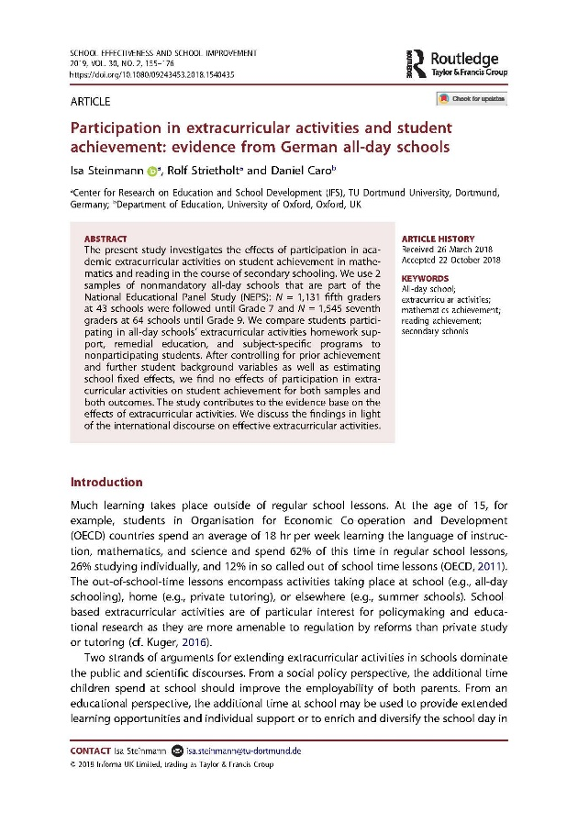
Research Question
Do homework support and remedial education offers affect the achievement of students who did not learn German as first language?
Notes:
- We therefore compare achievement developments between participating and nonparticipating students

Slide 34
Data
Non-native speaking students at schools with an at least weekly offer of both homework support and remedial education in Germany
Two samples from National Educational Panel Study (NEPS; Blossfeld, Roßbach, & von Maurice, 2011)
N = 315 students at 77 schools (grade 5 in 2010/2011 until grade 7 in 2012/2013)
N = 363 students at 94 schools (grade 7 in 2012/2013 until grade 9 in 2014/2015)

Slide 35
Instruments I
sample 5-7
sample 7-9
grade 5
grade 6
grade 7
grade 7
grade 8
grade 9
Dependent variables
Reading achievement
Mathematics achievement

Slide 36
Instruments II
sample 5-7
sample 7-9
grade 5
grade 6
grade 7
grade 7
grade 8
grade 9
Treatment variables
Participation vs. non-participation in homework support
Participation vs. non-participation in remedial education

Slide 37
Instruments III
sample 5-7
sample 7-9
grade 5
grade 6
grade 7
grade 7
grade 8
grade 9
Student-level control variables
Achievement & school grades (mathematics & reading/German)
Socioeconomic status, parental education, & parental employment
Homework help by parents and private tutors

Slide 38
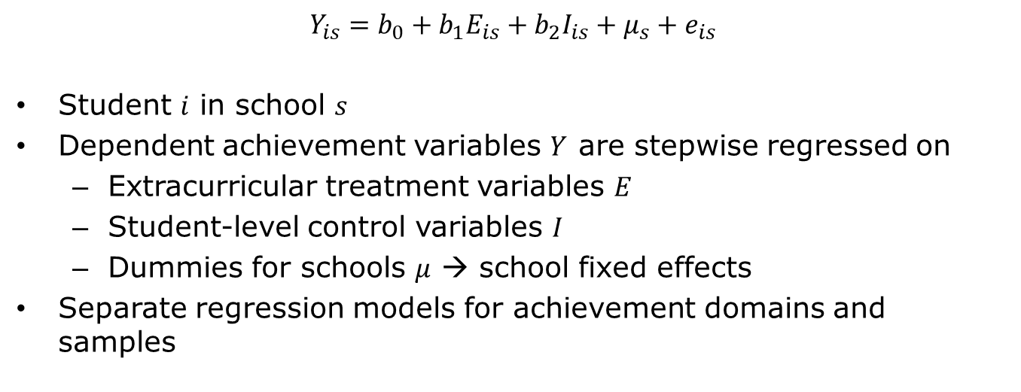
Analyses
Notes:
There is student and school level confounding

Slide 39
Descriptive Findings
Homework support
23% participants in sample 5-7
12% participants in sample 7-9
Remedial education
24% participants in sample 5-7
13% participants in sample 7-9
Participating and non-participating non-native speaking students had rather similar background characteristics

Slide 40
Inferential Findings
No significant effects once prior achievement is controlled
Achievement regressed on treatments
Achievement regressed on treatments and prior achievement
Achievement regressed on treatments and all student-level controls
Achievement regressed on treatments, student-level controls, and school fixed effects
Both treatments, both achievement domains, and both samples

Slide 41
Limitations
Treatment variables
Simple participation vs. non-participation at one point in time
Homework support and remedial education rather domain-overarching and broad terms
Dependent variables
Focus on mathematics and reading achievement in standardized tests
Summative approach
No investigation of mediating quality factors
No experimental data

Slide 42
Acknowledgment
This study uses data from the National Educational Panel Study (NEPS) Starting Cohort Grade 5; doi:10.5157/NEPS:SC3:7.0.1. From 2008 to 2013, NEPS data were collected as part of the Framework Program for the Promotion of Empirical Educational Research funded by the German Federal Ministry of Education and Research (BMBF). As of 2014, NEPS is carried out by the Leibniz Institute for Educational Trajectories (LIfBi) at the University of Bamberg in cooperation with a nationwide network.

Slide 43
Thank you very much!
WERA-IRN 2019
Dr. Isa Steinmann
isa.steinmann@tu-dortmund.de

Slide 44
References I
Autorengruppe Bildungsberichterstattung (2016): Bildung in Deutschland 2016: Ein indikatorengestützter Bericht mit einer Analyse zu Bildung und Migration. Bielefeld: W. Bertelsmann Verlag
Bellin, N. & Tamke, F. (2010): Bessere Leistungen durch Teilnahme am offenen Ganztagsbetrieb? Empirische Pädagogik, 24, 93–112
Blossfeld, H.-P., Roßbach, H.-G., & von Maurice, J. (Eds.) (2011). Education as a lifelong process – The German National Educational Panel Study (NEPS). Zeitschrift für Erziehungswissenschaft: Sonderheft 14
BMBF (2012). Ganztägig bilden: Eine Forschungsbilanz. http://www.ganztagsschulen.org/_media/121206_BMBF_GTS-Forschungsbilanz_bf_df.pdf
Fischer, N., & Klieme, E. (2013). Quality and effectiveness of German all-day schools. Results of the Study on the Development of All-Day Schools in Germany. In J. Ecarius, E. Klieme, L. Stecher, & J. Woods (Eds.), Extended education – an international perspective: Proceedings of the international conference on extracurricular and out-of-school time educational research (pp. 27–52). Opladen [i.a.]: Barbara Budrich Publishers

Slide 45
References II
Fischer, N., Sauerwein, M. N., Theis, D., & Wolgast, A. (2016). Vom Lesenlernen in der Ganztagsschule: Leisten Ganztagsangebote einen Beitrag zur Leseförderung am Beginn der Sekundarstufe I? Zeitschrift für Pädagogik, 62(6), 780–796
Linberg, T., Struck, O., & Bäumer, T. (2018). Vorzug Ganztagsschule? Zusammenhänge mit der Kompetenzentwicklung im Bereich Lesen und Mathematik. Zeitschrift für Erziehungswissenschaft, 14(2), 1–23
Lossen, K., Tillmann, K., Holtappels, H. G., Rollett, W., & Hannemann, J. (2016). Entwicklung der naturwissenschaftlichen Kompetenzen und des sachunterrichtsbezogenen Selbstkonzepts bei Schüler/-innen in Ganztagsgrundschulen: Ergebnisse der Längsschnittstudie StEG-P zu Effekten der Schülerteilnahme und der Angebotsqualität. Zeitschrift für Pädagogik, 62(6), 760–779
Rubin, D. B. (1987). Multiple imputation for nonresponse in surveys. New York, NY: Wiley
Stanat, P., Schipolowski, S., Rjosk, C., Weirich, S., & Haag, N. (2017). IQB-Bildungstrend 2016: Kompetenzen in den Fächern Deutsch und Mathematik am Ende der 4. Jahrgangsstufe im zweiten Ländervergleich. Münster, New York: Waxmann

Slide 46
References III
Stecher, L., & Maschke, S. (2013). Research on extended education in Germany – A general model with all-day schooling and private tutoring as two examples. International Journal for Research on Extended Education, 1(1), 31–52
Steiner, C. (2011). Teilnahme am Ganztagsbetrieb. Zeitliche Entwicklung und mögliche Selektionseffekte. In N. Fischer, H. G. Holtappels, E. Klieme, T. Rauschenbach, L. Stecher, & I. Züchner (Eds.), Ganztagsschule: Entwicklung, Qualität, Wirkungen: Längsschnittliche Befunde der Studie zur Entwicklung von Ganztagsschulen (StEG) (pp. 57–75). Weinheim [i.a.]: Beltz Juventa
Steinmann, I., Strietholt, R. & Caro, D. (2019). Participation in Extracurricular Activities and Student Achievement: Evidence from German All-Day Schools. School Effectiveness and School Improvement, 30(2), 155–176
Wendt, H., Goy, M., Walzebug, A., & Valtin, R. (2016). Bildungsangebote an Ganz- und Halbtagsgrundschulen in Deutschland. In H. Wendt, W. Bos, C. Selter, O. Köller, K. Schwippert & D. Kasper (Hrsg.), TIMSS 2015. Mathematische und naturwissenschaftliche Kompetenzen von Grundschulkindern in Deutschland im internationalen Vergleich (S. 225–246). Münster, New York: Waxmann Verlag

Slide 47
What would you say are advantages
of pretest data and fixed-effects
models?

Slide 48
Pretest and fixed-effect models
If pretest data on the outcome is available, this is usually a very good control variable
→ good proxy for any selection mechanisms (correlated with treatment/control allocation AND outcome)
In truly longitudinal models (more than two measurement points), one can compare individuals with themselves
In certain cases, fixed-effects models can help cover selection mechanisms
→ e.g., school-fixed effects controls for any differences on school and higher levels

Slide 49

Recommended reading
https://us.sagepub.com/en-us/nam/fixed-effects-regression-models/book226025

Slide 50

Recommended reading
https://methods.sagepub.com/book/longitudinal-research

Slide 51
Questions?

Slide 52
Midway evaluation
What do you like about the course?
What could be improved?

Slide 53
Take-away messages
Matching methods can be useful complementation of regression methods but they do not solve omitted variable bias
Pretest variables are usually very valuable control variables
Fixed-effects can be valuable additions to control strategies

Slide 54
Required reading for next week
5 | Regression Models Time: 31 January 2022, 12:15-14:00h Main instructor: Isa Steinmann Required reading: Angrist & Pischke (2015), chapter 2
6 | Further Control Strategies Time: 03 February 2022, 12:15-14:00h Main instructor: Isa Steinmann Required reading: -
7 | Instrumental Variable Approaches Time: 07 February 2022, 12:15-14:00h Main instructor: José Manuel Arencibia Alemán Required reading: Angrist & Pischke (2015), chapter 3
8 | Regression Discontinuity Designs I Time: 10 February 2022, 12:15-14:00h Main instructor: José Manuel Arencibia Alemán Required reading: Angrist & Pischke (2015), chapter 4

Slide 55
Thanks for your attention!
Isa Steinmann
isa.steinmann@cemo.uio.no

Slide 56
References
Grogan, K. E. (2012). Parents’ choice of pre-kindergarten: the interaction of parent, child and contextual factors. Early Child Development and Care, 182(10), 1265–1287. doi:10.1080/03004430.2011.608127.
Hirshberg, D., Huang, D. S.-C., & Fuller, B. (2005). Which low-income parents select child-care? Family demand and neighborhood organizations. Children and Youth Services Review, 27(10), 1119–1148. doi:10.1016/j.childyouth.2004.12.029.
Ho, D., Imai, K., King, G., & Stuart, E. (2011). MatchIt: Nonparametric preprocessing for parametric causal inference. Journal of Statistical Software. Retrieved from http://gking.harvard.edu/matchit.
Hogrebe, N. (2014). Bildungsfinanzierung und Bildungsgerechtigkeit. Der Sozialraum als Indikator für eine bedarfsgerechte Finanzierung von Kindertageseinrichtungen. Wiesbaden: Springer VS.
Hogrebe, N. & Strietholt, R. (2016). Does non-participation in pre-school affect children’s reading achievement? International evidence from propensity score analyses. Large-Scale Assessment in Education, 4(1), 1–22.

Slide 57
References
Kim, J., & Fram, M. S. (2009). Profiles of choice: Parents’ patterns of priority in child care decision-making. Early Childhood Research Quarterly, 24(1), 77–91. doi:10.1016/j.ecresq.2008.10.001.
Rosenbaum, P. R., & Rubin, D. B. (1983). The central role of the propensity score in observational studies for causal effects. Biometrika, 70(1), 41–55. doi:10.1093/biomet/70.1.41.
Steinmann, I., Zieger, L. R., Hogrebe, N. & Strietholt, R. (2016). Lesen Kinder, die nicht in der Kita waren, am Ende der Grundschule schlechter? In R. Strietholt, W. Bos, H. G.Holtappels & N. McElvany (Eds.): Jahrbuch der Schulentwicklung Band 19: Daten, Beispiele und Perspektiven (pp. 161-185). Beltz Juventa
Stuart, E. A. (2010). Matching Methods for Causal Inference: A Review and a Look Forward. Statistical Science, 25(1), 1-21.
Zachrisson, H. D., Janson, H., & Nærde, A. (2013). Predicting early center care utilization in a context of universal access. Early Childhood Research Quarterly, 28(1), 74–82. doi:10.1016/j.ecresq.2012.06.004.

